Slide 1
Spring Framework

Slide 2
Spring Web MVC

Slide 3
Lesson Objective
This course helps you to understand and implement Spring MVC Framework.

Slide 4
MVC
Spring offers rich support in the Web Tier:
  Spring MVC
    Spring’s own implementation of the Model 2 MVC architecture
    Flexible request mapping and handling
    Full forms support
    Supports multiple view technologies
    JSP Tag Library
  Support for Existing Web Frameworks
    Struts
    Tapestry
    JavaServerFaces
    WebWork

Slide 5
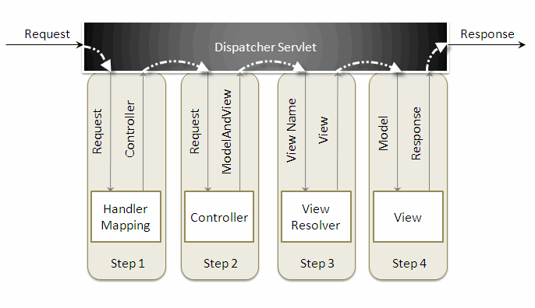
MVC

Slide 6
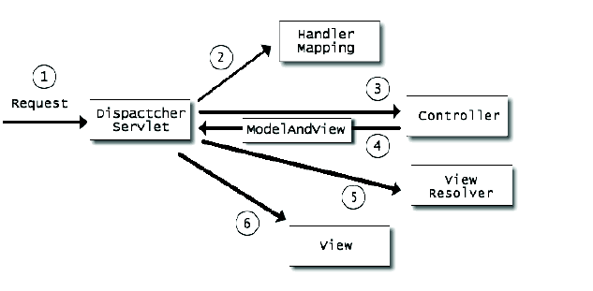
MVC
Spring MVC Lifecycle:

Slide 7
MVC
When a request is sent to the Spring MVC Framework the following sequence of events happen,
  The DispatcherServlet first receives the request.
  The DispatcherServlet consults the HandlerMapping and invokes the Controller associated with the request.
  The Controller process the request by calling the appropriate service methods and returns a ModeAndView object to the DispatcherServlet. The ModeAndView object contains the model data and the view name.
  The DispatcherServlet sends the view name to a ViewResolver to find the actual View to invoke.
  Now the DispatcherServlet will pass the model object to the View to render the result.
  The View with the help of the model data will render the result back to the user.

Slide 8
Spring in the Web Tier
Setting up a typical Spring MVC:
  Configure web.xml to map requests to Spring Front Controller
    Similar to Struts setup
  Configure web.xml to have Spring read additional bean definition files, if necessary ([servlet name]­servlet.xml loaded automatically)
    Spring supports either 2.3 (listeners) or 2.2 (startup servlet)
    Allows multiple bean configuration files to be loaded into single Application Context
  Write Controller classes and configure them in xml file
    Must map the controller to one or more URLs via an implementation of a HandlerMapping object
  Configure one or more view resolvers to tie controllers to views (JSP, Velocity template, etc.)
  Write the JSPs or other view artifacts to render the user interface

Slide 9
For more information please contact:
T+ 33 1 98765432
F+ 33 1 88888888
M+ 33 6 44445678
firstname.lastname@atos.net

